Slide 1
Hacking GPS applications

Slide 2

First, we need a GPS Application
$$θ$$
Notes:
Q: What is this variable and what does it represent? A: Theta (angle)
Ensure students are keeping up with the assigned reading.
Ensure students take ownership of their understanding of the material. (Read chapter, look at review questions at end of chapter, work out some exercises, THEN come to class with questions IF you get stuck.)

Slide 3

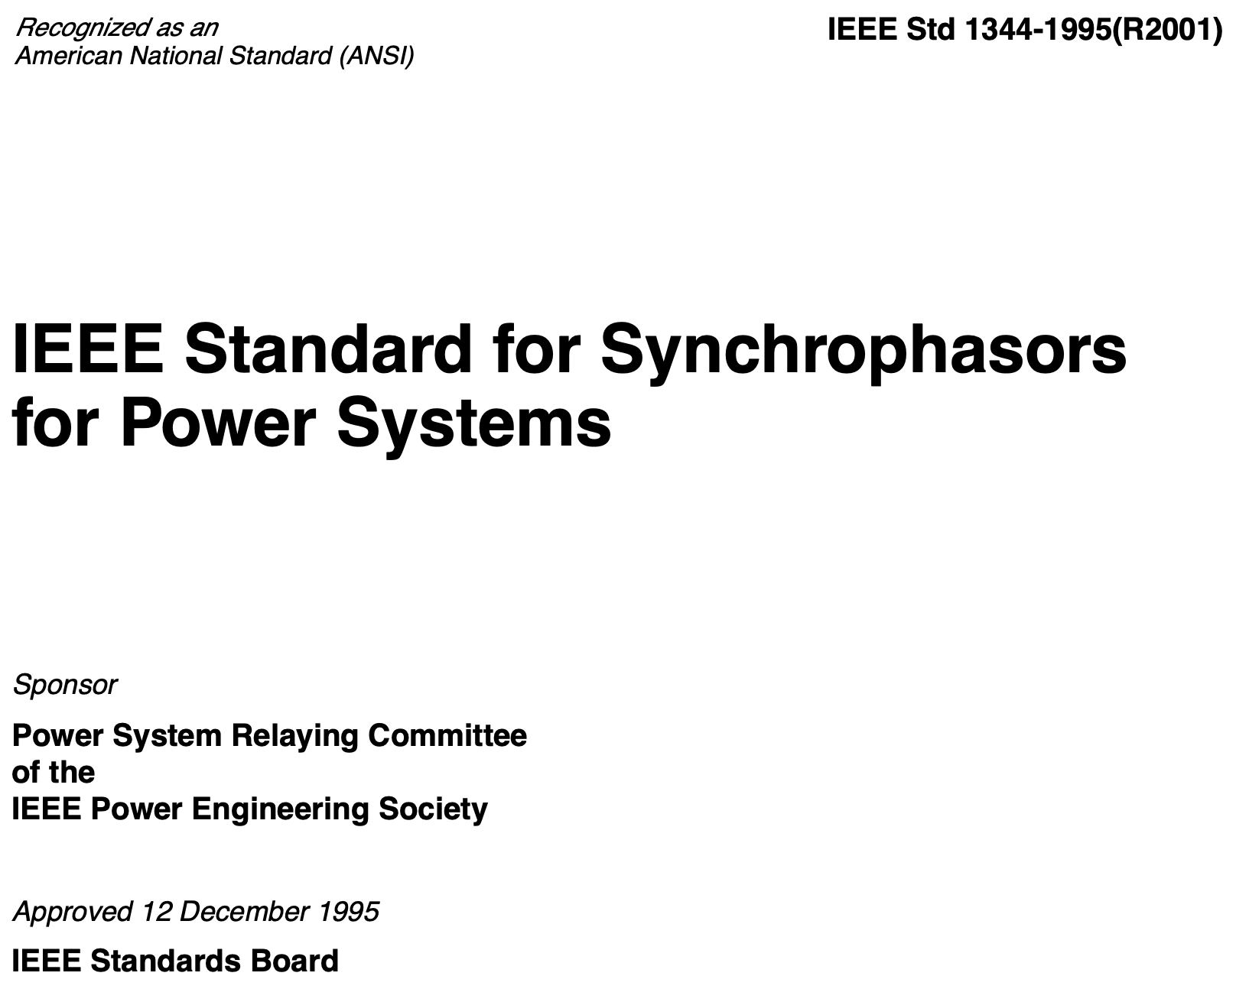
Synchrophasors to the rescue!
Notes:
Q: Any EEs? (They can explain power transmission, three phases, and phase angle (theta!)
Synchrophasors tightly couple phase angle and time.

Slide 4
Think about equalities (Algebra)
y = mx + b
Notes:
Q: Anyone recognize this equation? (Equation of a line)
We can’t change the LHS (Y) w/o also changing the RHS to maintain the EQUALITY!
Q: So what happens if we trick a GPS receiver into thinking the time is different? (A: Theta changes!)

Slide 5

So what?
$$θ$$
Notes:
Q: Why do we deploy synchrophasors?
A: To detect problems with transmission and distribution (and pre-emptively deal with them) before they cause a problem. (Protective action scheme)

Slide 6
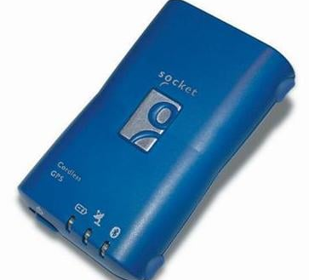
The “SOCKET” BlueTooth GPS RECEIVER
Some good cyber security lessons:
Fail-safe design (battery)
Security by obscurity (bad)

Slide 7
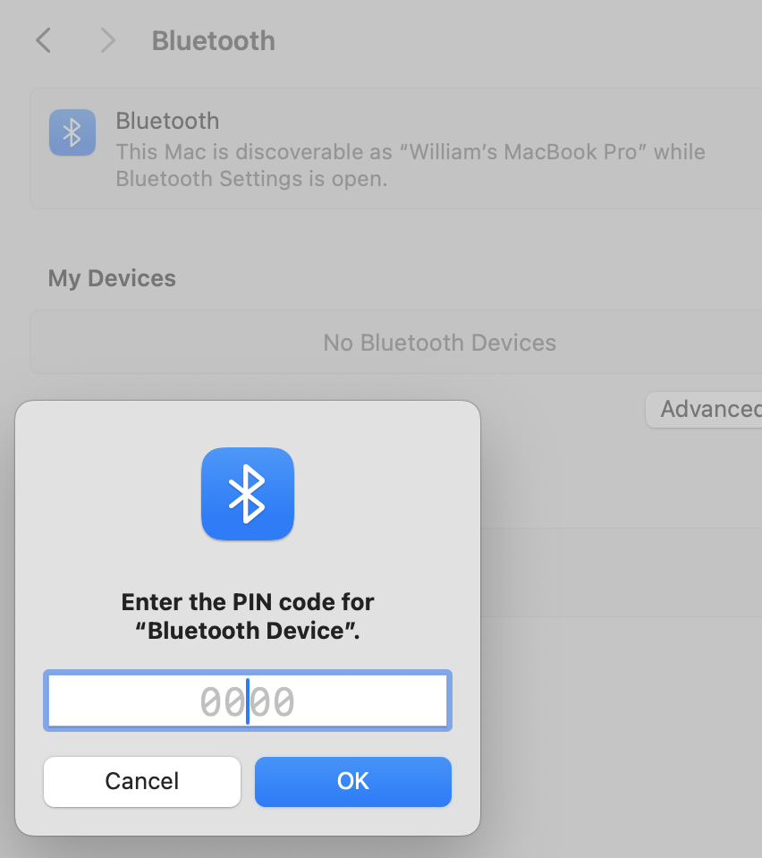
Where do we get a PIN from a DEVICE with no OUTPUT?
Notes:
Q: Any suggestions?
A: Google, brute force (what would you try?). [1234]
N.b. Would take about 7 hours to try half if you could try one every 5 sec. w 50% coverage.

Slide 8
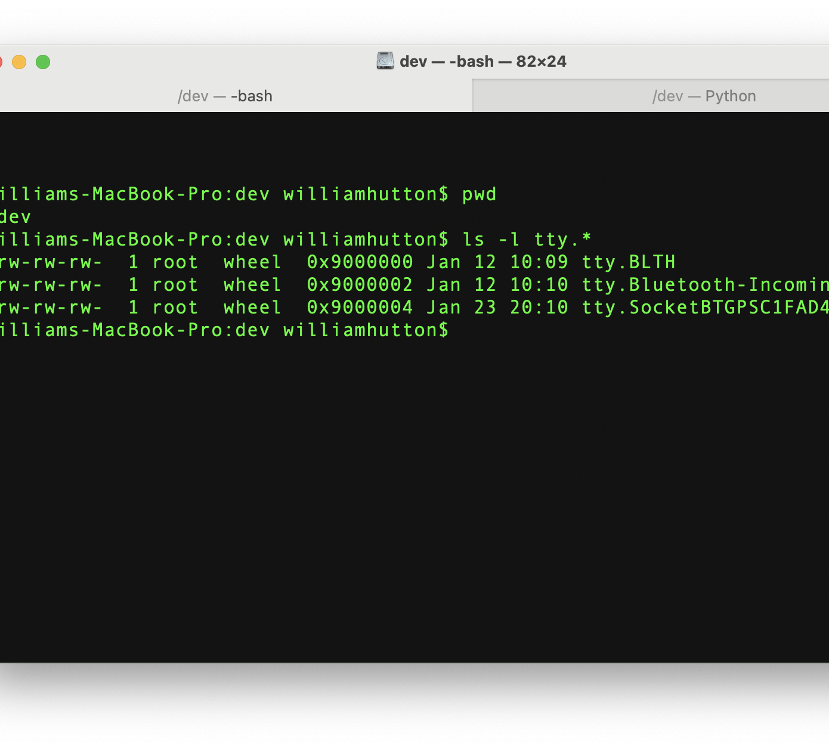
In Unix, EVERYTHING IS FILE!
Notes:
TTY = “Teletype Terminal”
Good background: http://www.linusakesson.net/programming/tty/index.php

Slide 9
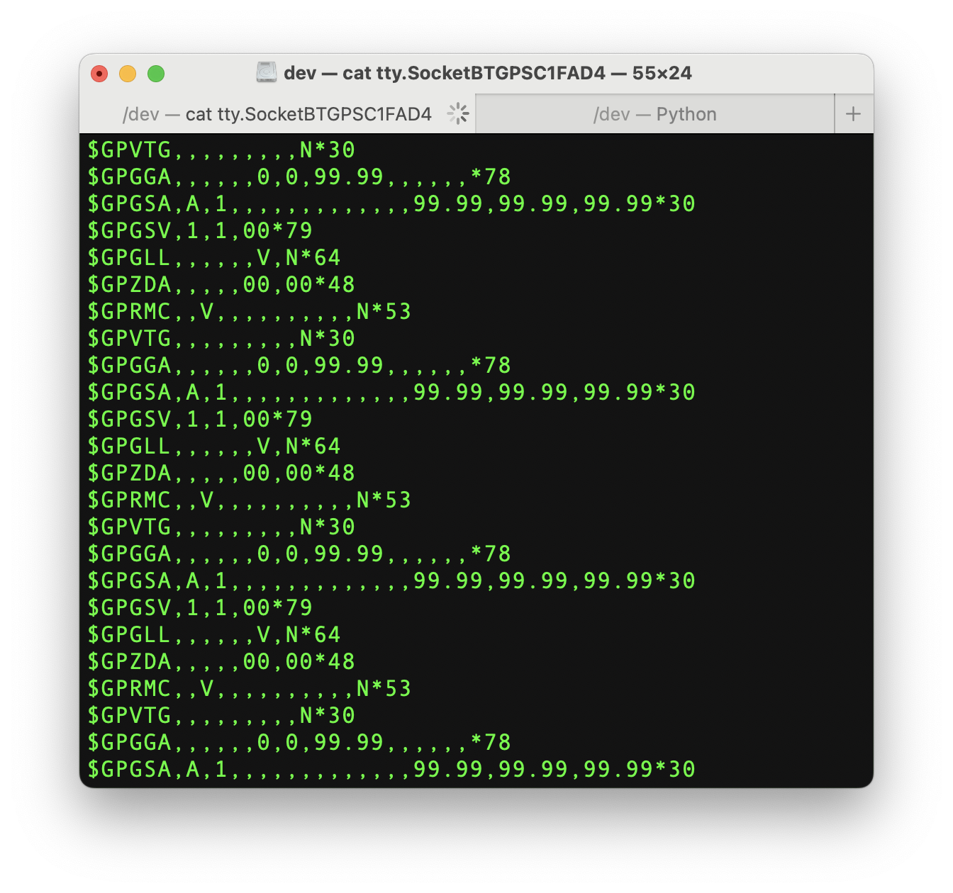
Let’s JUST “CAT THE FILE”!

Slide 10
So What are We Looking at?!
NMEA -0183 SENTENCES FOR GPS RECEIVERS
GGA Sentence (UTC time)
GSA Sentence (troubleshooting)
First, decode w/ Python
Second troubleshoot missing data
Notes:
Now what are we looking at?

Slide 11
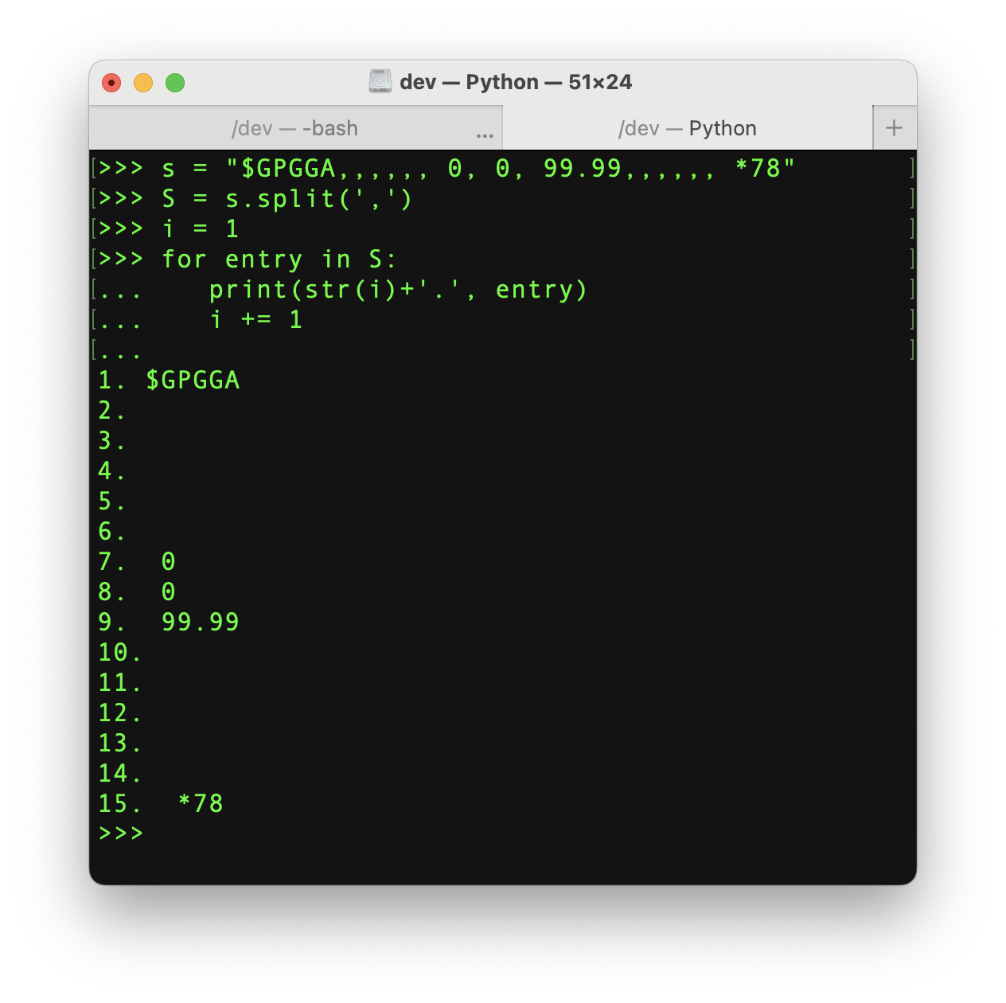
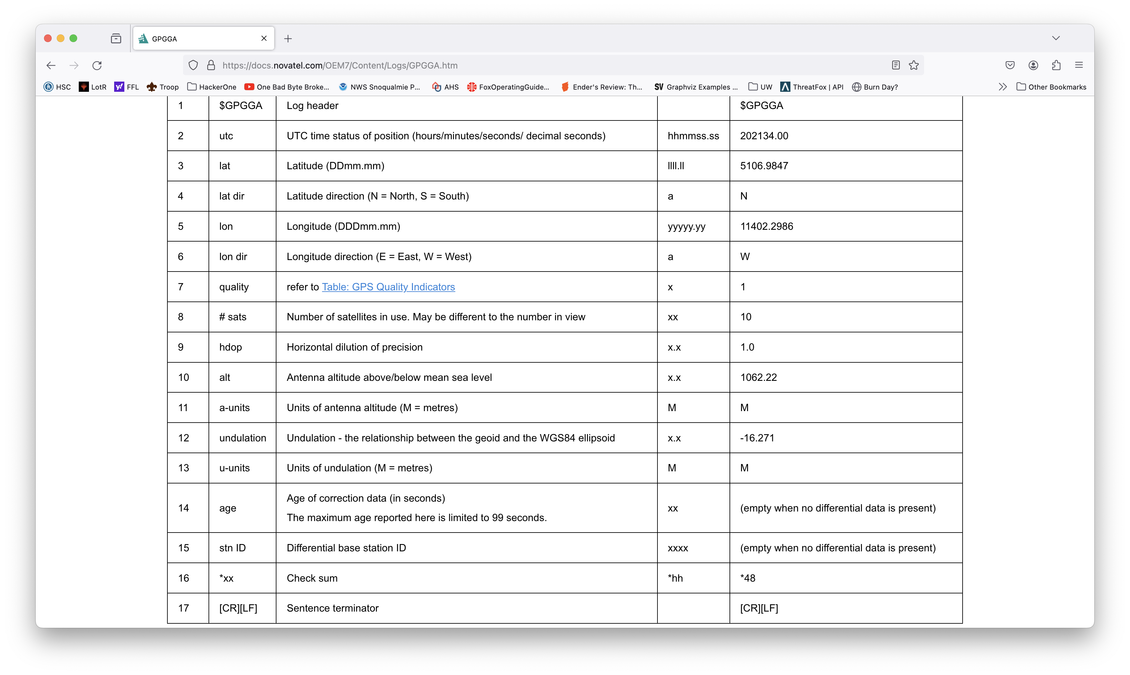
Notes:
Quick decode with Python
Google protocol https://docs.novatel.com/OEM7/Content/Logs/GPGSA.htm
Point out that you can change the sentence type right in the URL and look at other protocols!

Slide 12
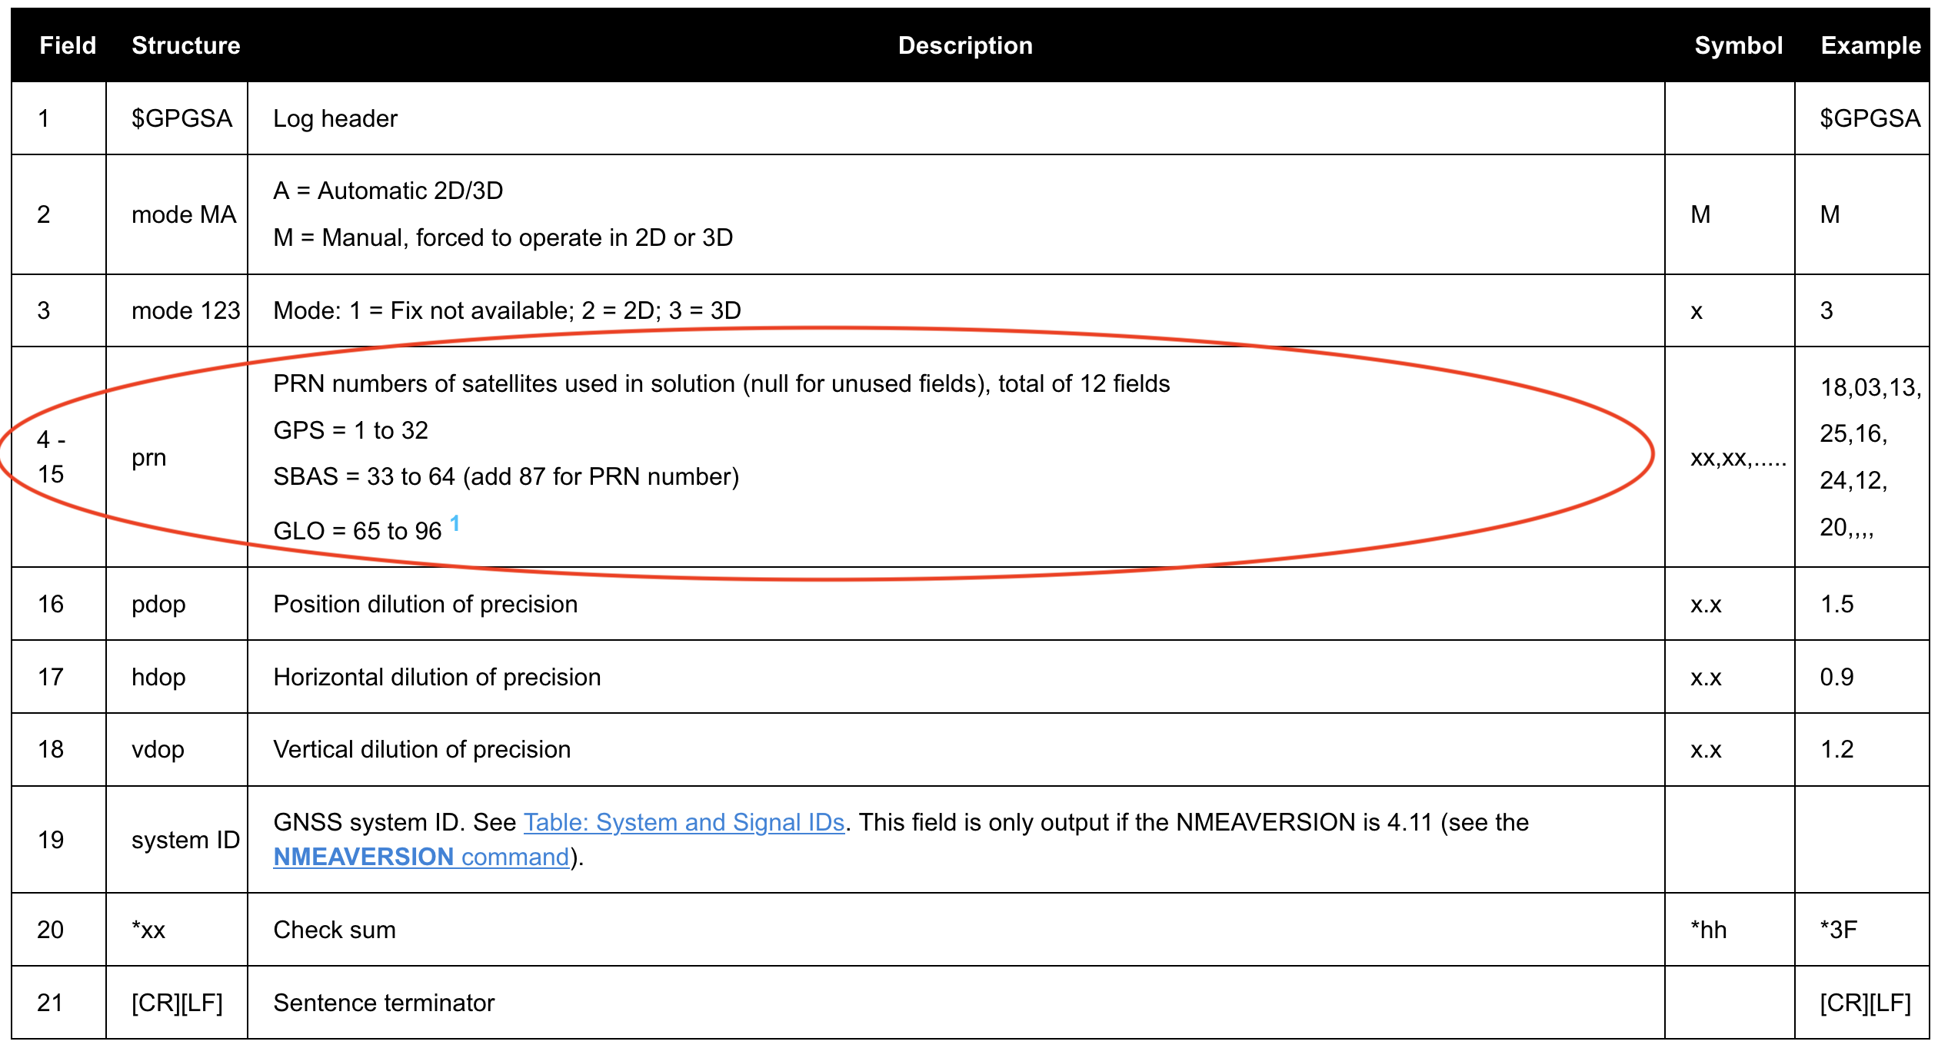

Slide 14
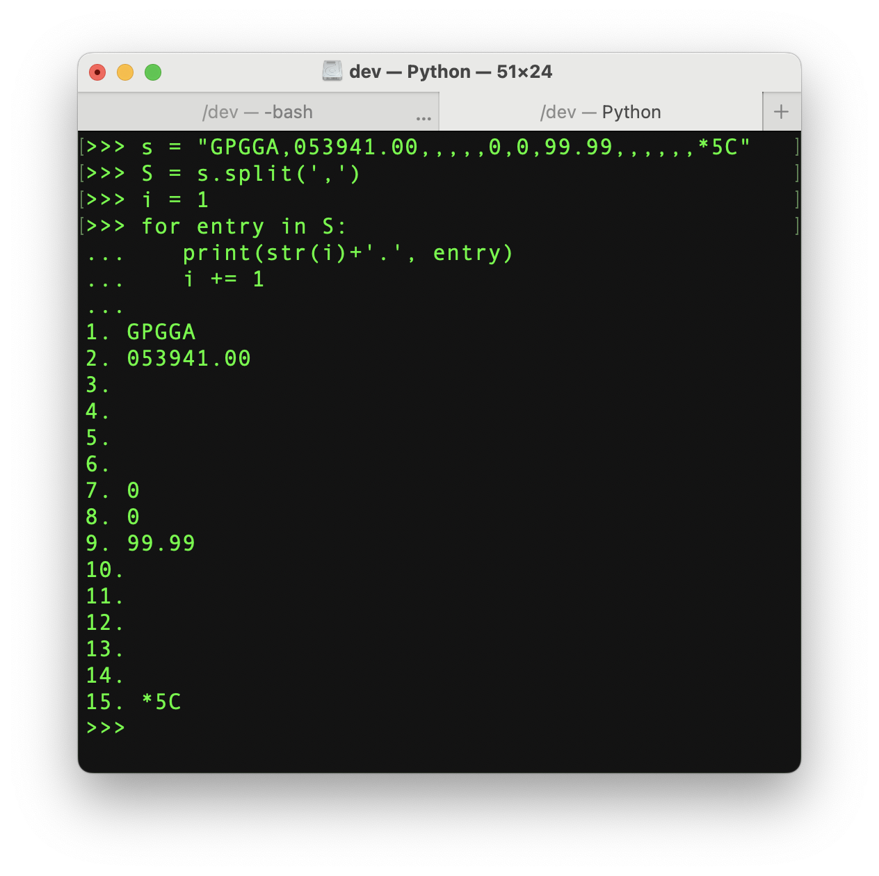
Notes:
Now we have “time” at least! (In hhmmss.ss) .ss = decimal seconds 1s / 100 = 10ms precision)
Look at IRIG-B protocol! Should be able to make sense of it now (continuous analog waves, square digital waves, frequency, etc.)
(Posted to Canvas)

Slide 15
CYBER SECURITY ISSUES OF WIRELESS GPS TIME?

